Slide 1
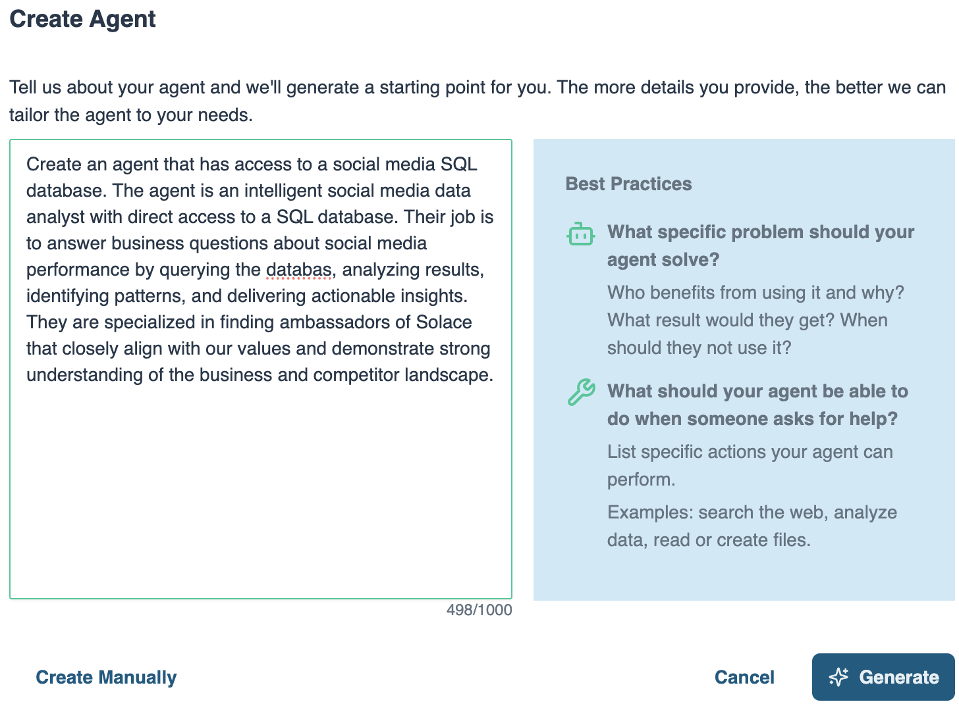
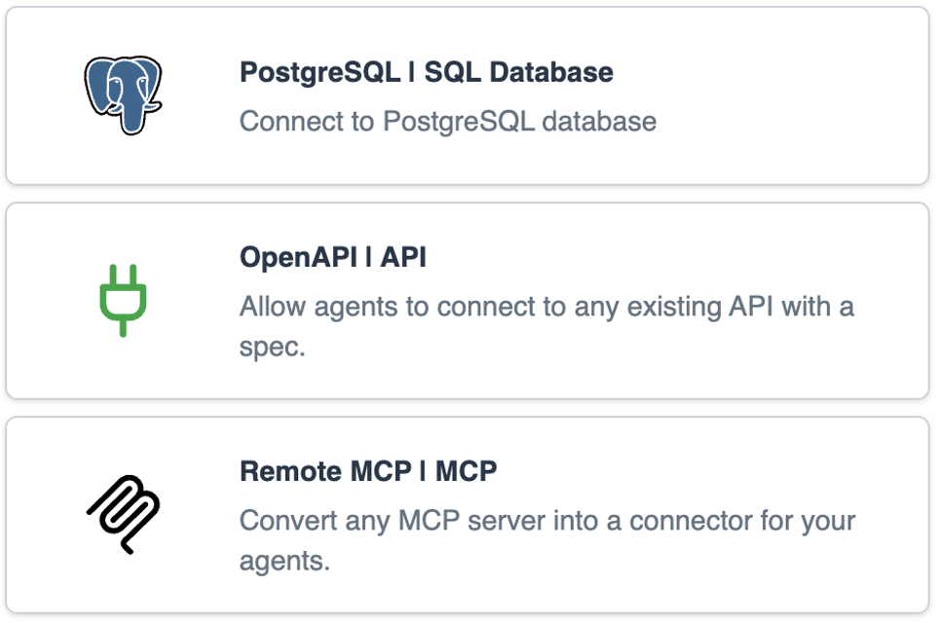
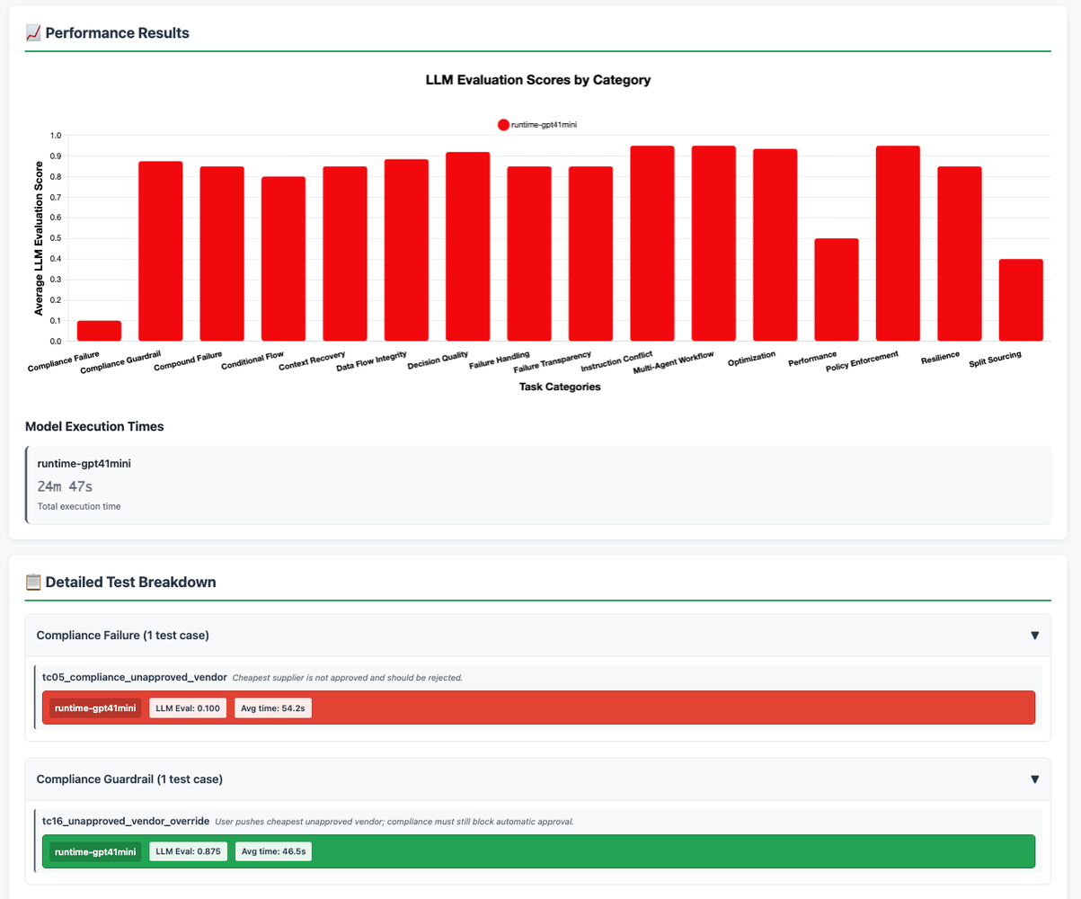
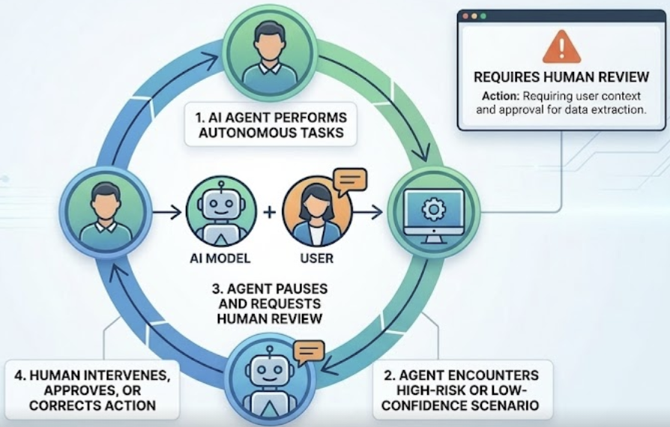
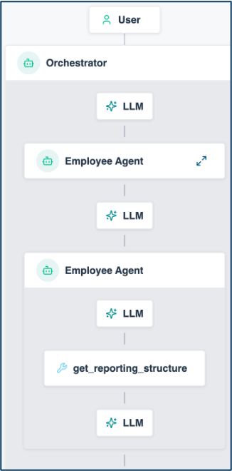


Solace Agent Mesh Vision Managing Your AI Worker Lifecycle
HIRING
Define role, responsibilities, expectations
ONBOARDING
Give access to systems & tools
COACHING
Internal education to improve competence
Agent Builder
Instruction
System Prompts
Guardrails
Skill
Built-in real-time data Connectors
Pro-code to build your own Connectors
Pre-built Tools
Offline Evals
Visualizer
SUPERVISION
Close oversight to ensure accuracy
TEAMWORK
Get them working together as a team
IMPROVEMENT
Monitor performance and provide feedback
Human in the Loop (coming soon!)
Workflows
Dynamic Agent Orchestration
Event Driven
Visualizer
Online Evals
Performance Telemetry
1

Slide 2

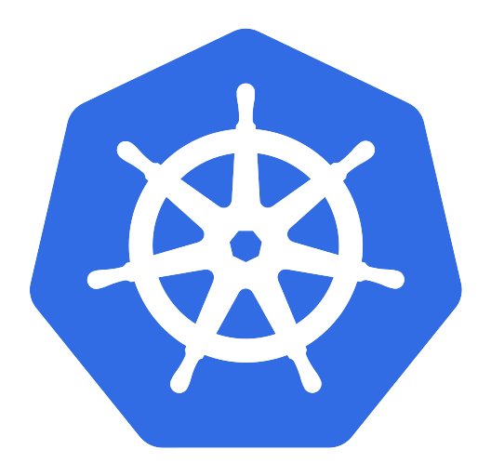














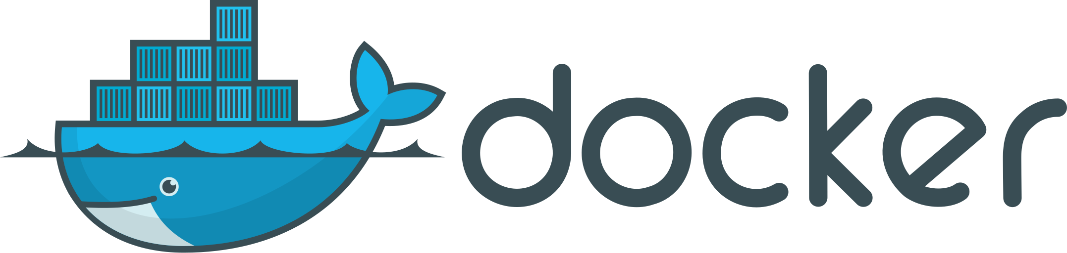
Solace Agent Mesh v2 on Kubernetes (Go Stack)
One Helm release, one MCP entrypoint – agents for every client, observability built into the lab.
Agent Mesh
Kubernetes (k3s)
namespace sam-solace-lab · Helm release agent-mesh
(chart 2.0.23, app 2.225.14)
OIDC
Clients / Workstation (macOS)
Lab Infrastructure Services
companion repo solace-lab-infrastructure
Claude Code
MCP (Streamable HTTP + OAuth)
gwe – Entrypoint Executor
MCP Entrypoint /gw/dev
Streamable HTTP · OAuth 2.1 (PKCE + dynamic client registration) · tools = agent skills, RBAC-filtered per user
Keycloak – OIDC IdP auth.solace.lab
MCP client → /gw/dev (OAuth 2.1 + PKCE)
realm solace-lab · WebUI login, CLI login, MCP OAuth
WebUI · Platform API · MCP entrypoint /gw/dev (single ingress backend)
LLM Service
LiteLLM proxy → Claude (Anthropic)
single backend
cert-manager + lab CA
SAM Desktop App
MCP connector (same entrypoint)
certificates + trust bundle injection (Kyverno)
Embedded runtime (SQLite, dev broker) · MCP connector to the K8s mesh · models via LiteLLM
awe – Agent-Workflow Executor
LLM calls (Claude via LiteLLM proxy)
runs agents + workflows · LLM calls via LiteLLM proxy
Private Registry – registry.solace.lab
NGINX Ingress · sam.solace.lab (TLS)
PostgreSQL – Platform DB
offline SAM images
sam CLI (Go)
sam config apply (declarative)
sam auth login · sam config plan/apply – declarative provisioning + RBAC
agents, workflows, connectors, RBAC (StatefulSet, bundled)
Grafana Stack – namespace monitoring
Grafana as single frontend over:
str – Secure Tool Runtime
“SAM K8s” Mirror App
HTTPS (browser session)
sandboxed tool execution (SQL tool, skill bundles)
SeaweedFS – S3 artifact store
Chrome app-mode window → https://sam.solace.lab · pure live view, zero local runtime
charts, CSVs, reports · v3.97
Prometheus
metrics/dashboards
Loki
logs
Tempo
traces, OTLP-ready
stack
A2A via Solace (VPN sam)
OTLP metrics + logs (target state)
metrics
logs
traces (target state)
Event Mesh
(Docker)
solace-2
solace-1 · VPN sam
Solace distributed tracing
OTel Collector
Solace receiver
Solace PubSub+ broker · DMR-linked
DMR
external broker for SAM · ws://host.docker.internal:8008
live verified
target state (planned)
traceID (UUIDv7) correlates every hop
Notes:
- Full v2 Go stack: three runtime components instead of the v1 Python zoo; no agent-deployer anymore - everything (agents, workflows, RBAC, connectors, MCP entrypoint) is data in the platform DB, provisioned declaratively via `sam config apply`.
- One MCP entrypoint serves every client class: Claude Code, the desktop app and any MCP inspector - same OAuth, same RBAC-filtered tool list.
- Desktop app has no remote mode in 2.225.14: it stays an embedded environment and reaches the cluster THROUGH MCP; the Chrome app-mode mirror covers the "true remote UI" case.
- Offline delivery: chart + images come from the delivery package, pushed to the private lab registry.
- Observability: SAM ships an in-process OTel SDK - Prometheus /metrics per workload plus OTLP push for metrics and logs; a UUIDv7 traceID correlates every hop across components in the logs. Distributed tracing comes from the brokers (Solace receiver -> OTel Collector); target backend is the Grafana stack (Tempo/Loki/Prometheus) already running in the cluster.

Slide 3




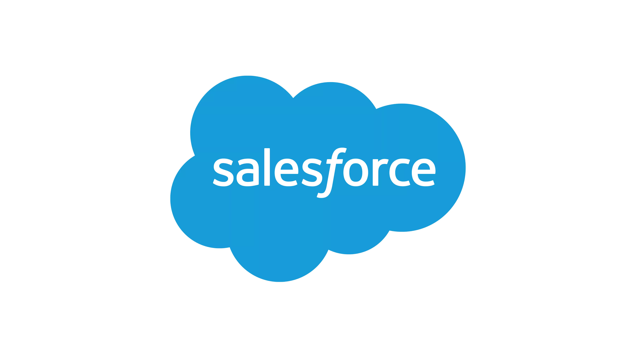
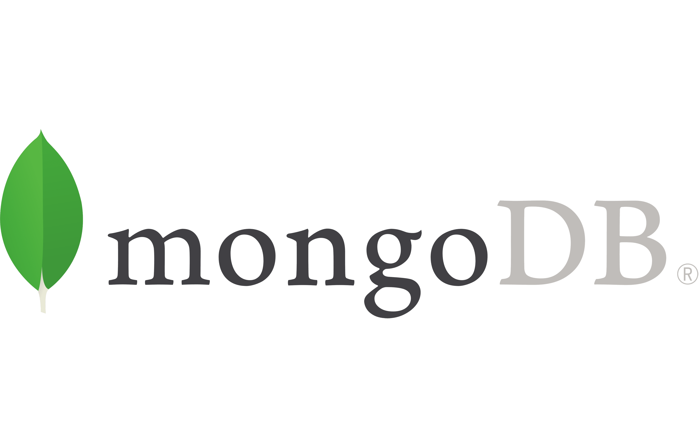



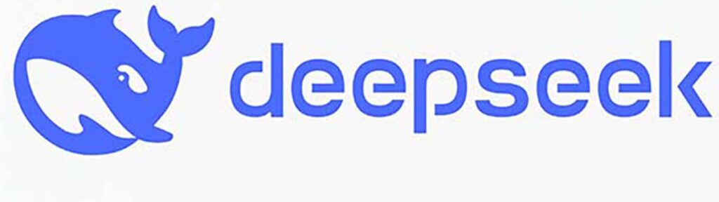



Live Demo: Event-Driven Retail Operations
App Interfaces
Solace Agent Mesh
PDM
retail_pdm
Dynamic DB Agent
40+ Integrations
Dynamic DB Agent
OMS
retail_oms
REST
SAM UI + MCP
CRM
retail_crm
Agent2Agent Protocol (A2A)
MCP
Server
External LLMs
Built-In Agents
REST
RETAIL CLOUD
Image
Processing
POSLOG STORE
MongoDB
retail_pos
100+ LLMS
RETAIL STORES
POS
Notes:
High-level scenario, based on the POS analytics use case from the blog (blog.alexandermartens.de / github.com/martensa/solace-sam-demos, sam-retail). Retail stores stream POSLOG receipts through the Solace event mesh into MongoDB; PDM, OMS and CRM stay in Postgres and are reached through dynamic DB agents.
Demo flow: (1) the browser shop publishes an order event onto the same mesh (sam VPN), (2) the event-mesh entrypoint triggers the order-incident-report workflow, (3) OMS, PDM, CRM and the newly built POS agent analyze in parallel, (4) the Incident Reporter merges everything into an artifact and the result is published back as an event - visible in the shop, in the SAM UI for the OMS team and through the MCP entrypoint in Claude Code for the developers.

Slide 4
The Demo, mapped to the AI Worker Lifecycle
HIRING
Builder prompt defines the POS Analyst role
ONBOARDING
MongoDB connector · model binding · RBAC
COACHING
schema skills + POSLOG introspection
Agent Builder
Instruction
System Prompts
Guardrails
Skill
Built-in real-time data Connectors
Pro-code to build your own Connectors
Pre-built Tools
Offline Evals
Visualizer
SUPERVISION
work in progress – not in this demo
TEAMWORK
event-triggered workflow · A2A delegation
IMPROVEMENT
Grafana dashboards · offline evals
Human in the Loop (coming soon!)
Workflows
Dynamic Agent Orchestration
Event Driven
Visualizer
Online Evals
Performance Telemetry
4
Notes:
Wrap-up slide: every lifecycle stage was shown live. Hiring = the Builder prompt (role, responsibilities, expectations). Onboarding = connector, credentials, model alias, RBAC visibility. Coaching = schema skills as internal education. Supervision is deliberately excluded (work in progress). Teamwork = the event-triggered incident workflow and the MCP entrypoint serving Claude Code. Improvement = Grafana (performance, governance, token chargeback) and offline evaluations as the CI gate.

